Slide 1
King county, Washington
Exploring Housing Prices and the Various factors contributing
Patrick Routh
March 7, 2019

Slide 2
King County, WA
Major Cities/Towns: Seattle, Bellevue
Population: 2,188,649
Most populous county in Washington
2,307 square miles (5,980 km²) land
Cascade Range, Granite Mountain
Twice the land area of Rhode Island
191 square miles (490 km²) water
Lakes, rivers, bays – Lake Washington, Puget Sound
Transportation
Major interstate highways
Metro transit
International Airport
Water taxis
Originally named for William Rufus DeVane King
Officially renamed after Martin Luther King Jr. in 2005

Slide 3
Question
Premise: I am a proud owner of a home in King County, WA. I want to increase the grade of my house given by the county from 5 to 7 to make it more attractive to buyers. I plan to renovate an element of my house or lot of land to improve its perceived value to a buyer.
Question: What should I do to improve the grade of my home and maximize its value?
Should I renovate my home and add an additional bathroom, or bedroom?
Or would I be better off cutting down the trees in the backyard to open up the view of the Cascade Range?

Slide 4
Evaluating the Data: Kings County House Sales Data Set
id - unique identified for a house
date - house was sold
bedrooms - of bedrooms per house
bathrooms - of bathrooms/bedrooms
sqft_living - footage of the home
sqft_lot - footage of the lot
floors- floors (levels) in house
waterfront - house which has a view to a waterfront
view - an index from 0 to 4 of how good the view of the property was
condition - quality measurement of house
grade - overall grade given to the housing unit, based on King County grading system
sqft_above - square footage of house apart from basement
sqft_basement - square footage of the basement
yr_built - built year
yr_renovated - year when house was renovated
zipcode - zipcode
lat - latitude coordinate
long - longitude coordinate
sqft_living15 - the square footage of interior housing living space for the nearest 15 neighbors
sqft_lot15 - the square footage of the land lots of the nearest 15 neighbors

Slide 5
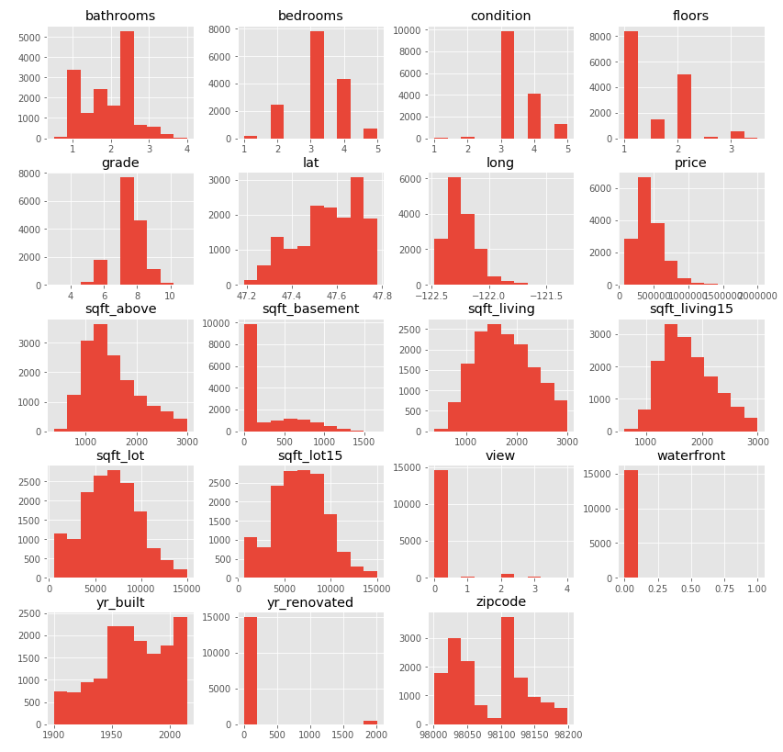
Evaluating the quality and Distribution of data
How good is this data?
Is this sample representative of the population?
21,597 initial total records, 20 initial features
900,000 homes in King County, WA
Cleaning required to remove:
Null/missing values
Human error inputs
Assess validity of features
Remove outliers

Slide 6
Approach
Goal: Identify the best features, plug into linear regression model, make intuitive insights
Determine Best Features
Linear Regression
Assumes that there is approximately a linear relationship between dependent variables and independent variables
Predictors – Features
Target – Price

Slide 7
Recommendations
Provide more details into how data was attained
Assuming that random sampling techniques were used
Distinguish between lakefront, riverfront, and bayfront properties
Diversity of bodies of water in King County, WA
Puget Sound, Lake Washington
Add proximity (in miles) to major cities as a feature
Seattle, Bellevue and others in county
Duration: time spent on commute to work
Access: types of transportation used

